Slide 1
PAI 724:
DATA DRIVEN DECISION MAKING
LAB
Week 3
September 19, 2022

Slide 2
LECTURE TOPIC
Conditional Execution and Functions

Slide 3
CONDITIONAL EXECUTION

Slide 4
BASIC LOGIC
INPUT evaluated to A
TRUE 🡪 Execute B
FALSE 🡪 Execute C
A
TRUE
FALSE
B
C

Slide 5
BASIC LOGIC
I
INPUT evaluated to A
TRUE 🡪 Execute B
FALSE 🡪 Execute C
if I == A:
B
else:
C
A
TRUE
FALSE
B
C

Slide 6
First the Boolean Expression/ Logic
I
A
TRUE
FALSE

Slide 7
BOOLEAN EXPRESSIONS
An expression that is True or False
True
False
Python determines these values with reference to comparison operators
Special values in Python
!= | is not equal to | <= | is less than or equal to
> | is more than | is | is the same as
< | is less than | is not | is not the same as
>= | is more than or equal to | == | is the same as

Slide 8
CODE BREAK

Slide 9
First the Boolean Expression/ Logic
‘five’
x == ‘five’
TRUE
FALSE

Slide 10
The executed Expression given a TRUE Boolean Expression
‘five’
if
:
x == ‘five’
TRUE
FALSE
print(‘the same’)

Slide 11
The executed Expression given a TRUE Boolean Expression
The executed Expression given a FALSE Boolean Expression
‘Five’
if
:
x == ‘five’
TRUE
FALSE
else
:
print(‘the same’)
print(‘not the same’)

Slide 12
CODE BREAK

Slide 13
6
if
:
h > 6
TRUE
FALSE
else
:
print(‘taller’)
print(‘shorter’)
PROBLEM:
6 is not shorter than 6

Slide 14
Use ‘elif’ for additional evaluations
6
if
:
h > 6
TRUE
FALSE
elif
:
print(‘taller’)
h == 6
TRUE
FALSE
else
:
print(‘same’)
print(‘shorter’)

Slide 15
CODE BREAK

Slide 16
Use ‘and’ for evaluation ranges
6
if
:
h > 6
TRUE
FALSE
elif
:
print(‘taller’)
h<=6
and
h>=5
TRUE
FALSE
else
:
print(‘same’)
print(‘shorter’)

Slide 17
WHAT IS A FUNCTION?
A function is a named sequence of statements that performs a computation

Slide 18
WHY USE FUNCTIONS?
Allows the programmer to reuse the same set of instructions but with different values, in the same or different programs
Can eliminate repetitive code
Functions segment code in a way that makes it easier to understand and debug

Slide 19
EXAMPLE
type()
print()
input()
…

Slide 20
EXAMPLE
type ()
Defined function
Follows same naming convention as variables
Python – built in functions and ability to define functions
Value or variable that is passed through function
Called “argument” or “parameter”
Often changes with multiple iterations of function execution

Slide 21
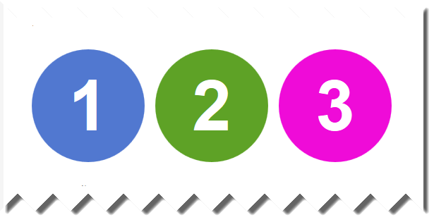
CREATING A NEW FUNCTION
Defining function with name and sequence of statements
“Calling” a function for execution

Slide 22
GENERAL FORMAT OF SCRIPT
def function_name () :
statement
statement
...

Slide 23
GENERAL FORMAT OF SCRIPT
def function_name () :
statement
statement
...
Make sure to include a colon
Statement following defining statement should be offset
Can have multiple lines of statements, and different forms of execution embedded in function instructions
and importantly…

Slide 24
CODE BREAK

